Slide 1
Darllen Stori
Geirfa/Vocabulary
llyfr/llyfrau book/books
stori/storiau story/stories
awdur author
cymeriad(au) character(s)
llun/lluniau picture(s)
tudalen(nau) page(s)
Mae hi’n amser stori. It’s story time.
Gwrandewch ar y stori. Listen to the story.
Edrychwch ar y lluniau. Look at the pictures
Darllenwch gyda fi. Read with me.
Trafod y stori/Discussing the story
Beth ydy teitl y stori? Pwy ydy hwn/hon? Sawl ____ sy yn y llun?
What is the title of the book? Who is this? (masc./fem.) How many _____ are in the picture? Beth ydy hwn? Oes ___ yn y llun?
What is this? Is there a _____ in the picture? Oes / Nag oes yes/no
Dyma _____. Pa liw ydy’r ……?
Here is _______. Which colour is the …?
Beth sy’n digwydd yma? Ble mae’r………….?
What is happening here? Where’s the………….?
Mynegi barn/Expressing an opinion
Wyt ti’n hoffi _____? Ydw/Nag ydw
Do you like _______? Yes/No
Beth wyt ti’n hoffi yn y stori/llun? Dw i’n hoffi …
What do you like in the story/picture? I like …

Slide 2
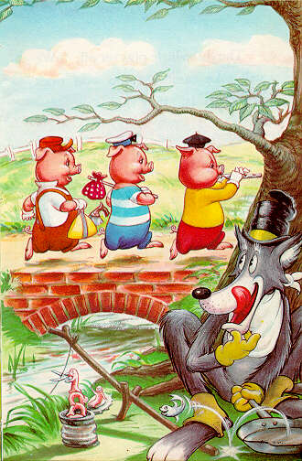
Y Tri Mochyn Bach
Trafod y stori / Discussing the story
Pwy sy’ yn y stori? Mae tri mochyn bach yn y stori.
Who’s in the story? There are three little pigs in the story.
Pwy arall sy’ yn y stori? Mae blaidd cas yn y stori.
Who else is in the story? There‘s an angry/nasty wolf in the story.
Pwy ydy hwn? Dyma’r mochyn bach/blaidd.
Who’s this?(masc.) Here’s the little pig/wolf
Beth mae’r mochyn bach yn gwneud? Mae’r mochyn bach yn adeiladu tŷ.
What’s the little pig doing? The little pig is building a house.
Pa fath o dŷ ydy hwn? Tŷ brics/Mae e’n dŷ brics.
What kind of house is this? A brick house/It’s a brick house.
Ble mae’r mochyn bach/blaidd? Mae’r mochyn bach yn y tŷ gwellt.
Where’s the little pig/wolf? The little pig is in the straw house.

